Slide 1


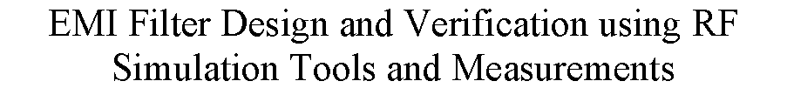

Slide 2
Contents
EMC & EMI | Emissions
EMI Filter Design | Common Mode Filter
 | Differential Mode Filter
Filter Behavior Analysis | Linear Analysis
 | Nonlinear Analysis
Case Studies | New CMC Analysis
 | EXP: USB1 Cable

Slide 3

EMC & EMI
EMC
EMI
EMS
Figure 01: EMC classification.
Figure 02: Measurement relationship between EMC classes[1].

Slide 4

Emissions
Intentional or unintentional generation of electromagnetic energy by a source.
Inherent to the switching voltages and currents within digital circuit.
Releases into the environment just after generation through air or conductors.
Classified into categories before propagating
Conducted emissions are dispersed with the use of interconnecting cables.
Figure 03: Generation of two emissions [2].

Slide 5
EMI Filter Design
Suppress electromagnetic noise transmitted through conduction.
Extract unwanted current conducted through wiring or cables, while allowing desirable currents to flow freely.
Often acts like a low-pass filters that sift out high frequencies while letting lower frequencies pass through.
After the filtering process, electromagnetic noise gets diverted away from the device and to the ground.
Should not be installed too close to the source or to the load, or too far away from the power line.
Categorized based on its generation, duration and bandwidth.

Slide 6
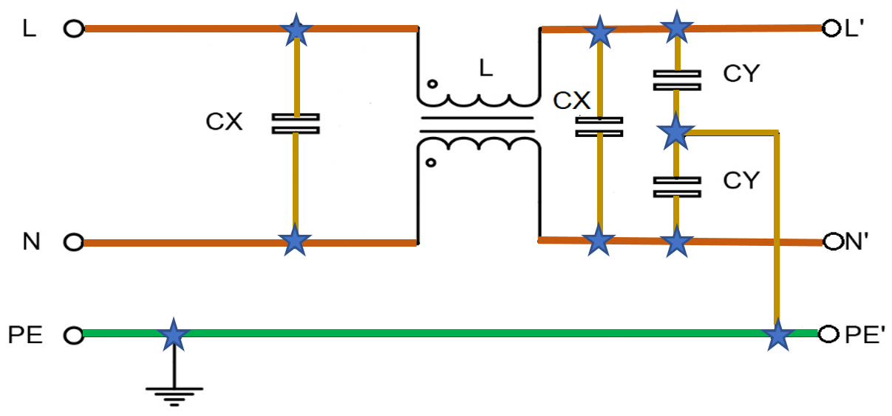
Standard EMI Filter selection
Figure 04: Standard schematic design of EMI filter [3].

Slide 7


Design Category
An EMI filter is divided into two sub filters designed according to the generation of noise.
Common mode filter
Differential mode filter
Figure 05: Common mode part in an EMI filter.
Figure 06: Differential mode part in an EMI filter.

Slide 8
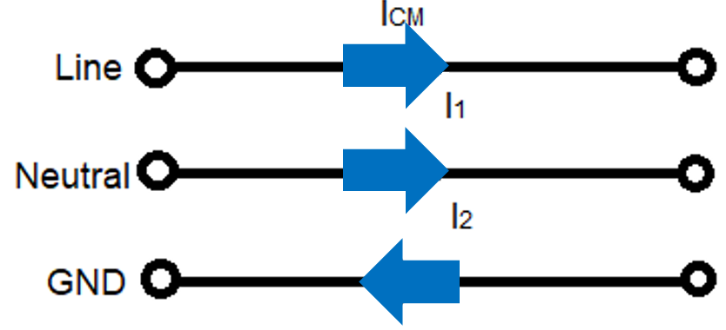
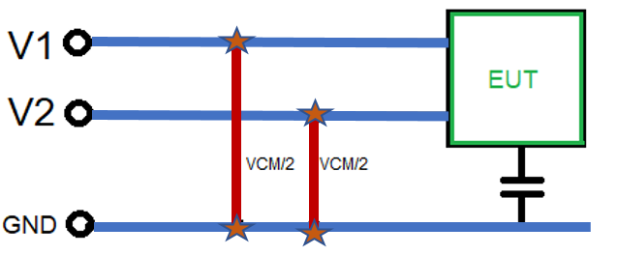
Common Mode Filter
A common mode voltage is an uneven and unbalanced voltage defined as the voltage between the conductor line and the ground, or as the mean of the phasor voltages appearing between each conductor and a specified reference, usually earth or frame.
V_{CM} = (V₁+V₂) / 2
Figure 07: Current flow path in a Common Mode Filter.
The current of the common mode noise flows in the same direction through the power line and the neutral and returns through the ground conductor.
I_{CM} = I₁ + I₂
Figure 08: Voltage measurement of a Common Mode Filter.

Slide 9
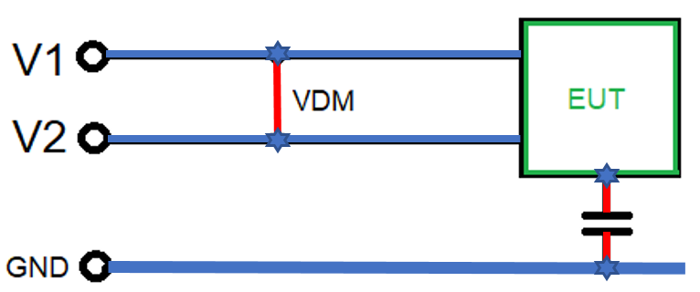
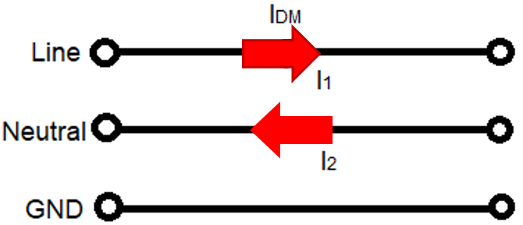
Differential Mode Filter
Differential mode currents flow in opposite directions and equal to the half of the vector difference of current that flows through line to neutral in cross-section area.
I_{DM} = (I₁ – I₂) / 2
Differential mode is also known as normal mode or symmetrical mode. It has a balanced voltage that is generated in between the line and neutral wires. It is the difference of the voltages of line and neutral.
V_{DM} = V₁ – V₂
Figure 09: Voltage measurement of a Differential Mode Filter.
Figure 10: Current flow path in a Differential Mode Filter.

Slide 10
Filter Behavior Analysis
To predict the filter behavior, entire analysis is classified into two categories:
Nonlinear analysis
This analysis includes:
Time domain measurements
    Voltage measurements
    Power measurements
Frequency domain measurements
    Voltage measurements (Vharm)
    Power measurement (Pharm)
Multi-tone measurements
    Sinusoidal Source
    Square wave Source
Linear analysis
This analysis includes:
S-parameter measurements
Insertion loss measurements
Reflection loss measurements
Transfer function measurements

Slide 11

Linear Analysis
S-parameters: Scattering parameters (S-parameters) describe the electrical behaviour of linear electrical networks when undergoing various steady state stimuli by electrical signals.
Figure 11: S-parameter measurement of Common Mode Filter and Differential Mode Filter.

Slide 12


Linear Analysis
Insertion loss: It is the ratio between the output power and the input power.
Insertion Loss = 10 log₁₀[Pout / Pin] dB = -20log₁₀[S21] dB
Figure 12: Insertion loss measurement of Common Mode Filter and Differential Mode Filter.

Slide 13
Linear Analysis
Reflection Loss: When a generated signal is to be passed through a transmission line, some of the energy is reflected back to the source.
Reflection Loss = 10 log₁₀[Preflected / Pincident] dB = |S11|
Figure 13: Reflection loss measurement of Common Mode Filter and Differential Mode Filter.

Slide 14
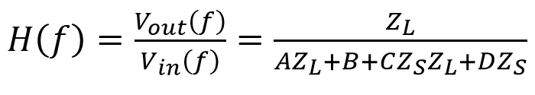
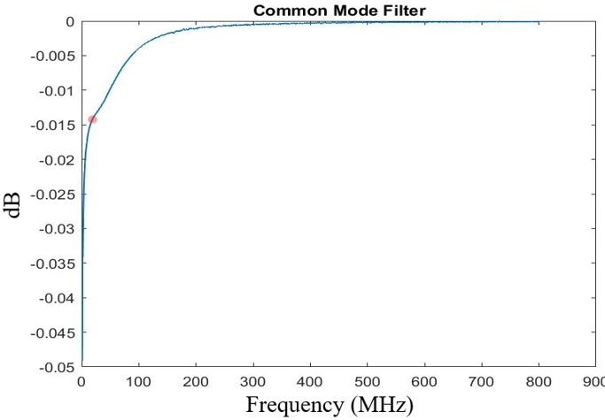
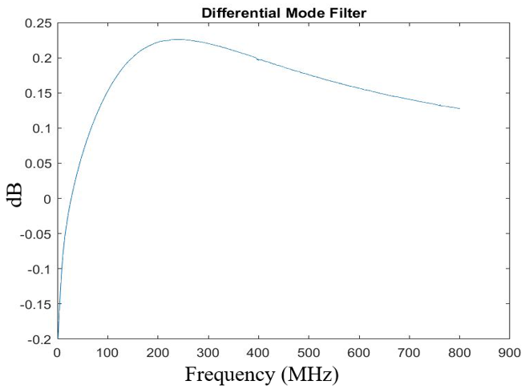
Linear Analysis
Transfer Function: A filter’s behaviour consisting it’s input output relationship at a given frequency can easily estimate using the transfer function.
Figure 14: Transfer function measurement of Common Mode Filter and Differential Mode Filter using ABCD-parameter.

Slide 15

Linear Analysis- Discussion
Input Impedance has been tested for both of the measured and simulated filter.
Insertion and reflection losses for both of the measured and simulated filter are compared and estimated the differences due to the internal losses of the components.
Calculations of the Transfer function for the both of the filter are as expected.
Very close results of the measured and simulated result proves the Filter’s efficiency.
Figure 15: Impedance of a Common Mode Choke from theory and measured results.

Slide 16
Nonlinear Analysis
Time domain analysis:
The best way to find out how a filter will work
Essential to determine signal distortion due to the non-linearity of the device
Signal value is determined of individual event for real numbers
Graph shows how a signal changes with time
Oscilloscope is used to see real signals in the time domain.
Frequency domain analysis:
Displays how much of the signal exists within a given frequency band.
Includes information of signals phase shift to recombine frequency components.
Solutions can be converted from time domain to frequency domain using Fast Fourier Transform.
Spectrum Analyzer is used to visualize electronic signals in the frequency domain.

Slide 17




Nonlinear Analysis-Time Domain
Voltage measurements: It is essential because the input output results estimate the existence of noise in a filter. Without any noise the voltage measurements are as following:
Figure 15: Common Mode Filter and Differential Mode Filter voltage measurement in time domain using sinusoidal signal.

Slide 18


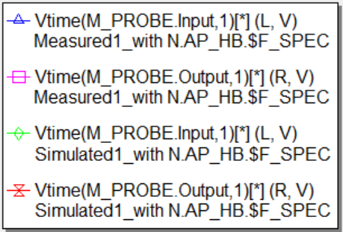
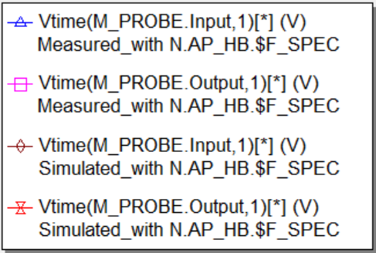
Nonlinear Analysis-Time Domain
With the involvement of noise the voltage measurements are as following:
Figure 16: CMF and DMF voltage measurement in time domain using sinusoidal noise .

Slide 19
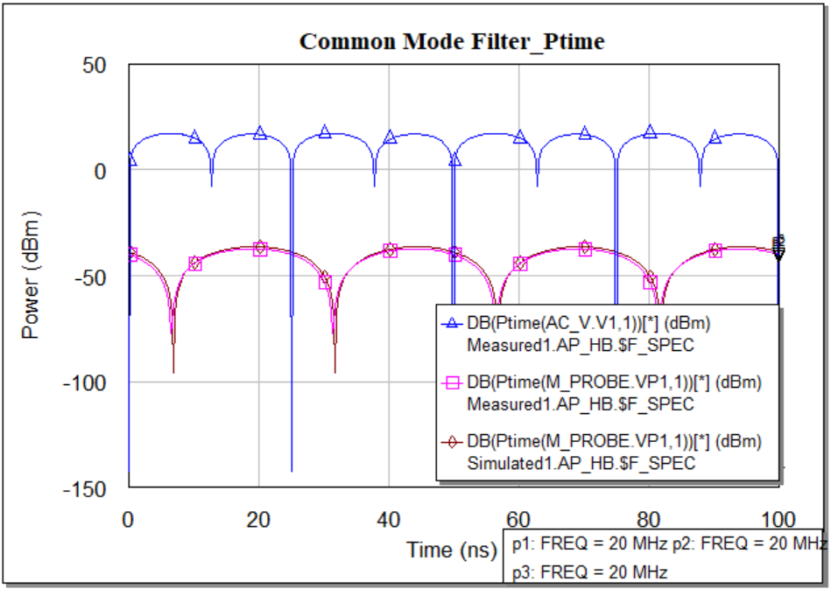
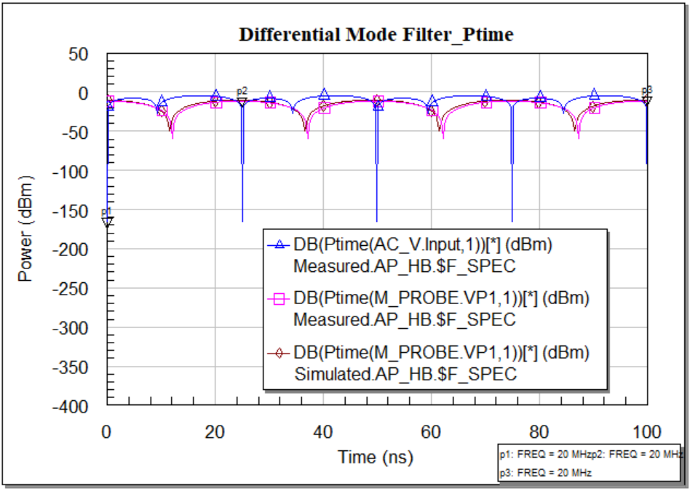
Nonlinear Analysis-Time Domain
Power measurements: It is essential because the input and output power estimates the filter quality. The simulated input output results without noise are like:
Figure 15: Common Mode Filter and Differential Mode Filter power measurement in time domain using sinusoidal signal.

Slide 20


Nonlinear Analysis-Time Domain
The simulation results for measuring power with the involvement of noise are in the following:
Figure 16: Common Mode Filter and Differential Mode Filter power measurement in time domain using sinusoidal noise.

Slide 21
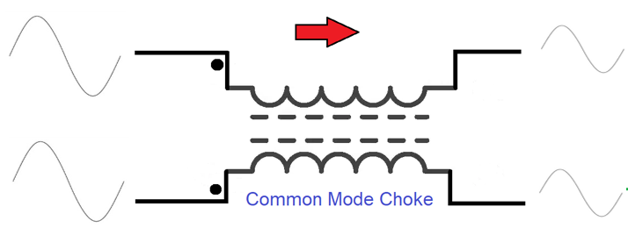
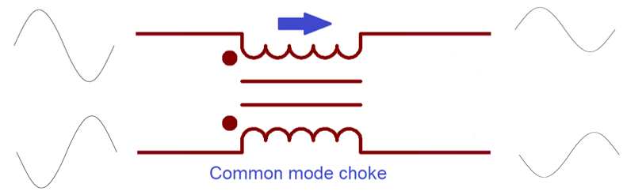
Time Domain- Discussion
For a single tone sinusoidal input signal, the measured and simulated output results are pretty similar except for the peak.
In the presence of noise the output voltage for both of the filter also results as expected.
In the time domain, the output power of measured and simulated filter gives nice and sharp transitions.
In the presence of noise, the output power indicates the good performance of the filter.
Figure 10: Expected input and output signal amplitude of a Common Mode Filter and Differential Mode Filter

Slide 22


Nonlinear Analysis-Frequency Domain
Voltage measurements: It is obtained after fast furrier transform of the time domain response. The simulation results having no noise source is in following:
Figure 17: Common Mode Filter and Differential Mode Filter voltage measurement in frequency domain.

Slide 23


Nonlinear Analysis-Frequency Domain
The simulation results of voltage measurements having noise source is in following:
Figure 18: Common Mode Filter and Differential Mode Filter voltage measurement in frequency domain using sinusoidal noise.

Slide 24
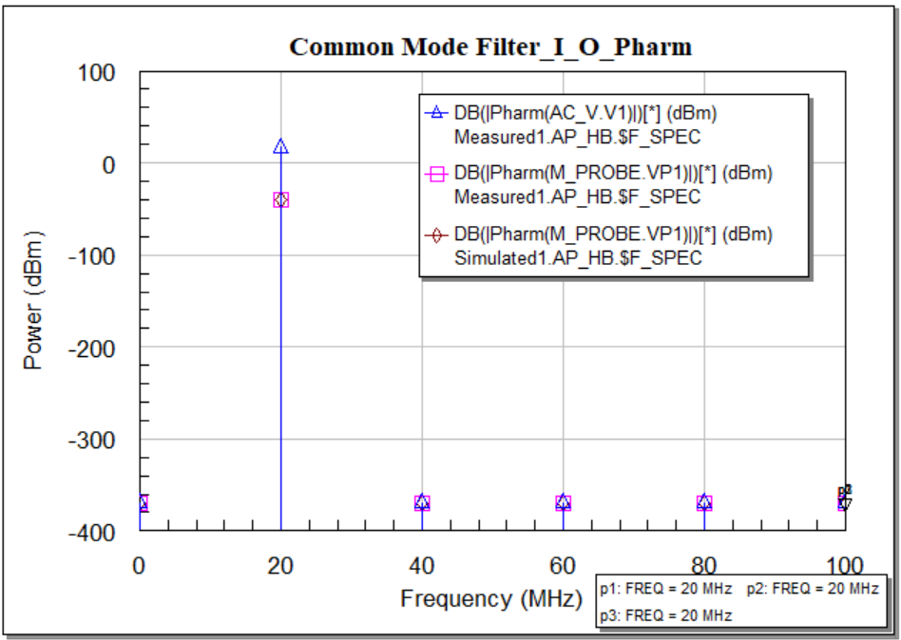
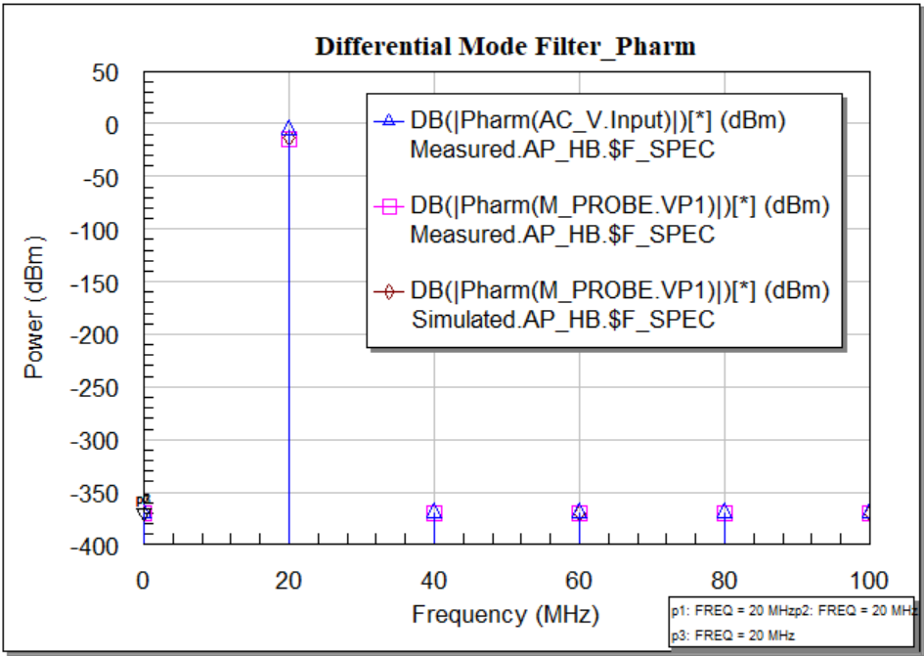
Nonlinear Analysis-Frequency Domain
Power measurements: It is essential because the harmonic output power estimates the power losses of the nonlinear system. Output power for both of the filter without noise is in followed:
Figure 19: Common Mode Filter and Differential Mode Filter power measurement in frequency domain.

Slide 25
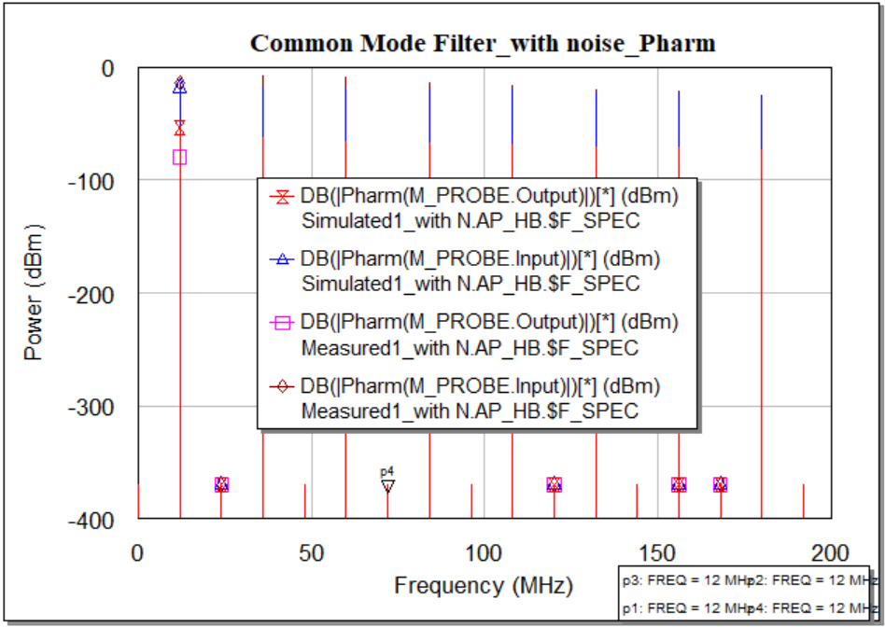
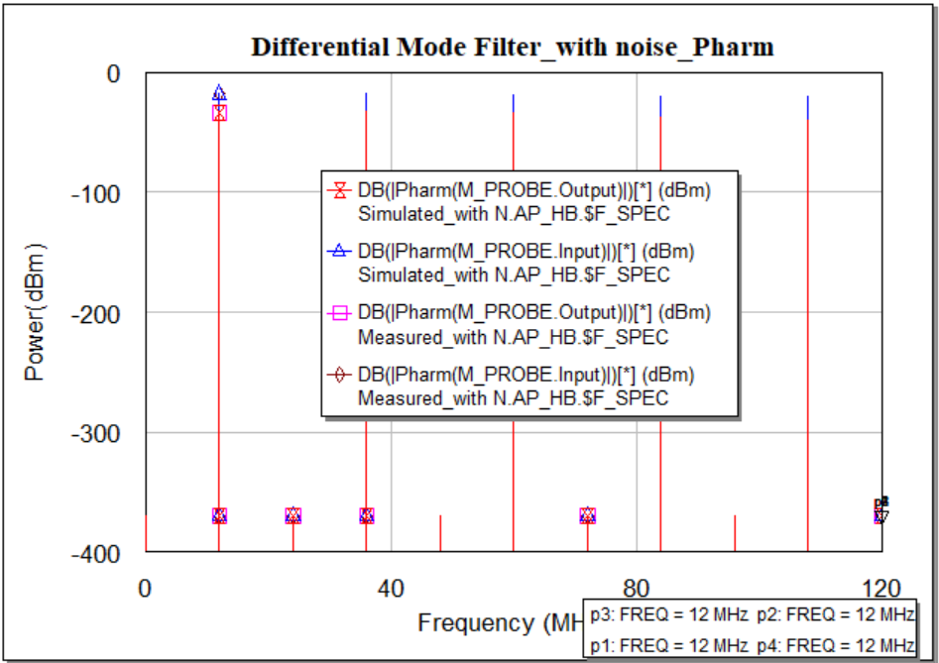
Nonlinear Analysis-Frequency Domain
Simulated Input and Output power for both of the filter with the noise are in followed:
Figure 20: Common Mode Filter and Differential Mode Filter power measurement in frequency domain using sinusoidal noise.

Slide 26




Nonlinear Analysis - Multi-tone
Voltage measurements: This simulation is completed using three sinusoidal signal source providing 1 volt of each tone and 20MHz, 40MHz, 100MHz of frequency respectively.
Figure 21: Common Mode Filter and Differential Mode Filter voltage measurement in time domain using three sinusoidal signal.

Slide 27




Nonlinear Analysis - Multi-tone
Another voltage measurements process is done in frequency domain.
Figure 22: CMF and DMF voltage measurement in frequency domain using three sinusoidal signal.

Slide 28




Nonlinear Analysis-Multi-tone
Power measurements: It is done considering three sinusoidal source as input and at the output
We have got power as follows.
Figure 23: Common Mode Filter and Differential Mode Filter power measurement in time domain using three sinusoidal signal.

Slide 29
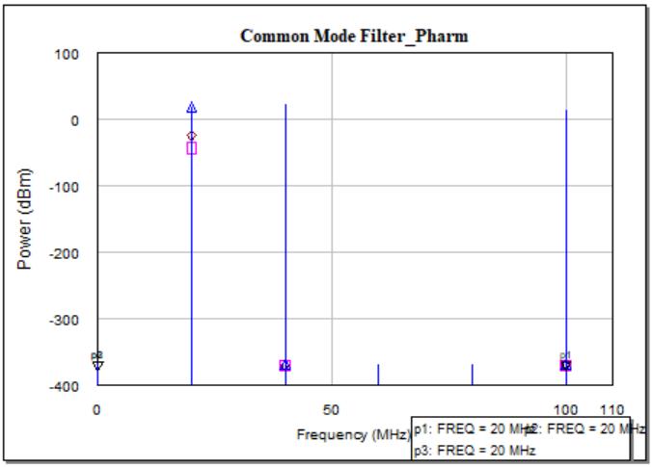
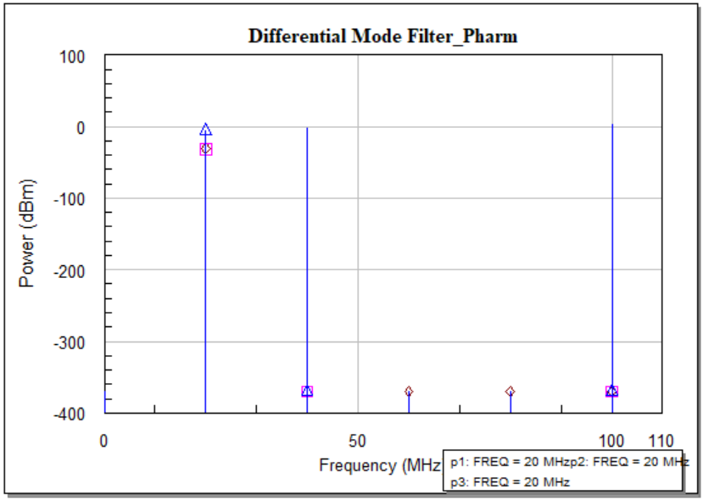
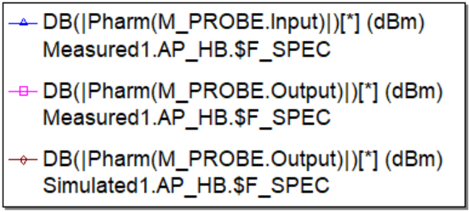
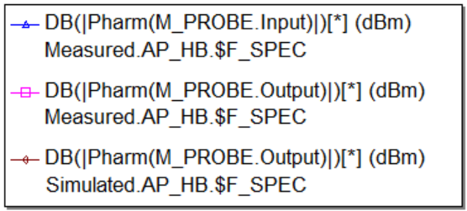
Nonlinear Analysis - Multi-tone
Power measurements process is done in frequency domain as harmonic power.
Figure 24: CMF and DMF power measurement in frequency domain using three sinusoidal signal.

Slide 30


Multi-tone- Discussion
Three Sinusoidal signal sources are used to do this test.
In the Common Mode Filter, The measured and simulated output voltage in time domain are almost matched except some drops in measured device due to real components.
For Differential Mode Filter, the amount of leakage inductance have made the magnitude and phases non matched
The sharp transitions of output power in time domain for both filters proves their better design.
Figure 47: Circuit design of CMF and DMF with multi-tone signal source.

Slide 31

CASE STUDY-New CMC
New CMC Test: Another model of Common Mode Choke is used and tested the previous type simulations. CMC is designed for 230V and 50Hz is taken for the test. Simulation for the voltage measurements are done having noise in input.
Figure 25: CMF and DMF voltage measurement in time domain using sinusoidal noise signal and new CMC.

Slide 32

CASE STUDY-New CMC
Simulation for the power measurements are done having noise in input.
Figure 29: CMF and DMF power measurement in time domain using sinusoidal noise signal and new CMC.

Slide 33
New CMC- Discussion
A common mode power line choke of inductance 2.2 mH, rated voltage 250V at 50Hz is used to perform this case study.
Only my proposed sets of capacitor are used in both of the filter for this case study.
Linear and Non-linear software simulation is accomplished for this case study.
The output rating voltage for this power line choke is higher than the previously used choke.
The output power in Figure 29 shows the decent rating that proves a better designed EMI filter.

Slide 34

CASE STUDY- USB1 cable
An USB 1 cable is considered to attend this case study. The simulated results for measuring voltage are given in the following figure.
Figure 27: CMF and DMF voltage measurement in time domain using sinusoidal noise signal with USB1 cable.

Slide 35

CASE STUDY- USB1 cable
The simulated results for measuring power are given in the following figure.
Figure 28: CMF and DMF power measurement in time domain using sinusoidal noise signal with USB1 cable.

Slide 36
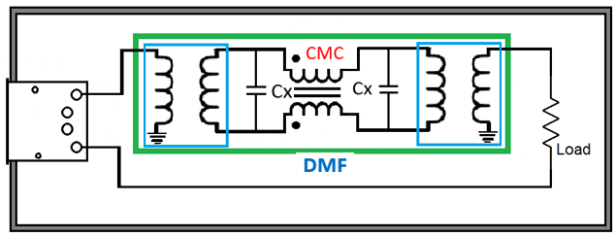

USB1 cable- Discussion
The line voltage of an USB1 cable is 5 V,
For an USB1 cable, the bandwidth is 12 MHz,
Among four cables, two cables are used for power transmission as twisted pair in USB1 cable,
In Voltage measurement, for CMF one sinusoidal wave defines the higher line voltage, and for DMF, the output voltage proves the phase shift of the signal.
Multiple transitions in output power response for the CMF and DMF proves the excellent time domain response but poor frequency domain response.
Figure 28: Circuit schematic of DM filter and CM filter with USB connection.

Slide 37
CASE STUDY- Ethernet cable
An Ethernet cable (cat5) is also used for this case study. The simulated results for measuring voltage are given in the following figure.
Figure 29: CMF and DMF voltage measurement in time domain using sinusoidal noise signal with Ethernet cable.

Slide 38
CASE STUDY- Ethernet cable
The simulated results of cat5 cable for measuring input output power are given in the following figure.
Figure 30: CMF and DMF power measurement in time domain using sinusoidal noise signal with Ethernet cable.

Slide 39
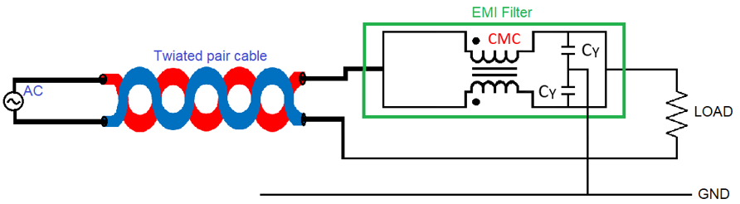
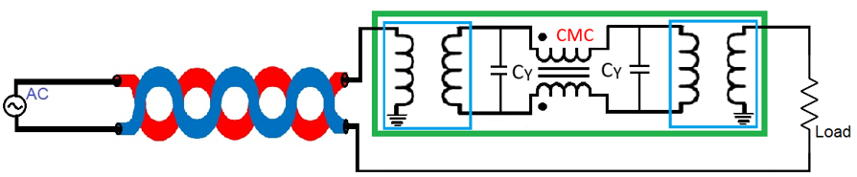
Ethernet cable-Discussion
The line voltage of an Ethernet cable (cat5) is nearly 2.5 V,
For cat5 Ethernet cable, the bandwidth is 100 MHz,
There are a total of four copper wires and each wire consists of two twisted wires,
In Voltage measurement, time domain response showing one sinusoidal wave because of the line voltage,
The output power lies between -41.9 dBm to -89.02 dBm where the input power lies between 24.32 dBm to -34.09 dBm.
Figure 31: Circuit schematic of Common Mode Filter and Differential Mode Filter with Ethernet cable.

Slide 40
References
[1]. A. V. S. Bhd, “ME1400 EMI AND EMC,” [Online]. Available: https://ppt-online.org/152151. [Accessed 11 October 2021].
[2]. K. A. KG, “EMC Considerations for Auxiliary Inverters in Electric Vehicles Applications,” 2021. [Online]. Available: https://www.kebamerica.com/blog/emc-considerations-in-electric-vehicle-applications/. [Accessed October 2021].
[3]. G. BOCOCK, “Match modular EMI AC line filters to application’s DC supply needs,” 28 FEBRUARY 2020. [Online]. Available: https://www.edn.com/match-modular-emi-ac-line-filters-to-applications-dc-supply-needs/. [Accessed 5 October 2021].
[4]. K. Bellero, “EMI FILTER DESIGN,” 23 May 2018. [Online]. Available: https://impulse.schaffner.com/en/engineers-guide-to-designing-emi-filter. [Accessed 1 October 2021].
[5]. C. Kathalay, A practical approach to Electromagnetic compatibility, Pune, India: EMC Publications, Pune, 2014.
[6]. C. Paul, Introduction to Electromagnetic Compatibility, John Wiley & Sons,, 1992.

